Slide 1
Win More Business! Report Product & Service Accessibility using VPAT® 2.1
Presented By:
Bill Curtis-Davidson
Senior Director, Strategic Consulting Services
CSUN 2018 Assistive Technology Conference
March 22, 2018
Voluntary Product Accessibility Template® and VPAT® are registered trademarks of Information Technology Industry Council (ITI).

Slide 2
Agenda
Win More Business! Report Product & Service Accessibility using VPAT® 2.1
Introduction to VPAT® 2.1
VPAT® 2.1 Structure & Best Practices
Get Started with VPAT® 2.1 Today
Q&A and Resources
Contacts
Voluntary Product Accessibility Template® and VPAT® are registered trademarks of Information Technology Industry Council (ITI).
Notes:
Introduction to VPAT® 2.1 (ITI)
Who is ITI?
Why ITI created VPAT® 2.1
Key differences between VPAT® 1.0 and 2.1
VPAT® 2.1 Structure & Tour (Level Access)
Getting Ready for VPAT® 2.1 (Level Access)
Understanding product coverage
Process for conformance statements
Q&A and Resources (Both)
Contacts (Both)

Slide 3
Introduction to VPAT® 2.1
Voluntary Product Accessibility Template® and VPAT® are registered trademarks of Information Technology Industry Council (ITI).

Slide 4

Who is ITI?
Introduction to VPAT® 2.1
Information Technology Industry Council (ITI)
Leading tech voice for 101 years and counting
62 tech businesses from across the globe
Long-time advocate for accessible technology
Voluntary Product Accessibility Template® and VPAT® are registered trademarks of Information Technology Industry Council (ITI).

Slide 5
What is a VPAT®?
Introduction to VPAT® 2.1
Voluntary Product Accessibility Template® (VPAT®)
Developed jointly by ITI and General Services Admin (GSA)
VPAT® 1.0 released in 2001 to support documentation of conformance to the original (1998) Section 508 standards
Goal: Help enable US Federal Government contracting officials and other buyers to make preliminary assessments of how commercial ICT products/services support accessibility.
Document template containing tables for documenting how technical standards and functional performance criteria met
Voluntary Product Accessibility Template® and VPAT® are registered trademarks of Information Technology Industry Council (ITI).

Slide 6
Why ITI Created VPAT® 2.1
Introduction to VPAT® 2.1
Refreshed Section 508
Trends favoring harmonized global approach
Address perceived shortcomings with VPAT® 1.0
Graphics: PixaBay
Voluntary Product Accessibility Template® and VPAT® are registered trademarks of Information Technology Industry Council (ITI).

Slide 7
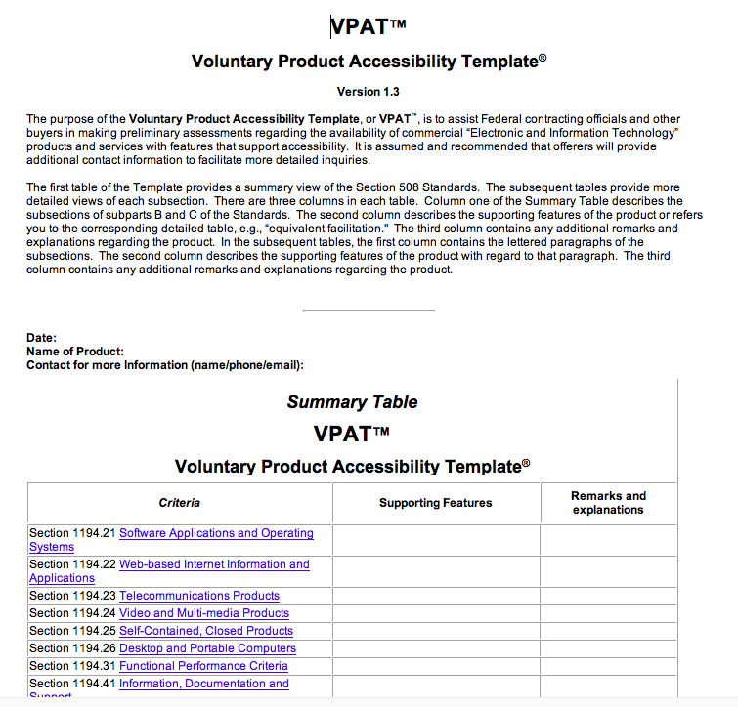
What’s the same as VPAT® 1.0?
Introduction to VPAT® 2.1
Voluntary
Freely available
Best practices
Market research tool
Collaboration with U.S. Government

Slide 8

What’s different from VPAT® 1.0?
Introduction to VPAT® 2.1
Three standards in one report
US Section 508 Refresh
Updated requirements for ICT covered by Section 508 of the Rehabilitation Act and Section 255 of the Communication Act
WCAG 2.0 Guidelines
Single shared standard for web content accessibility developed through W3C process which meets needs of individuals, organizations, and governments internationally.
Standard - EN 301 549
Accessibility requirements suitable for public procurement of ICT products and services in Europe

Slide 9

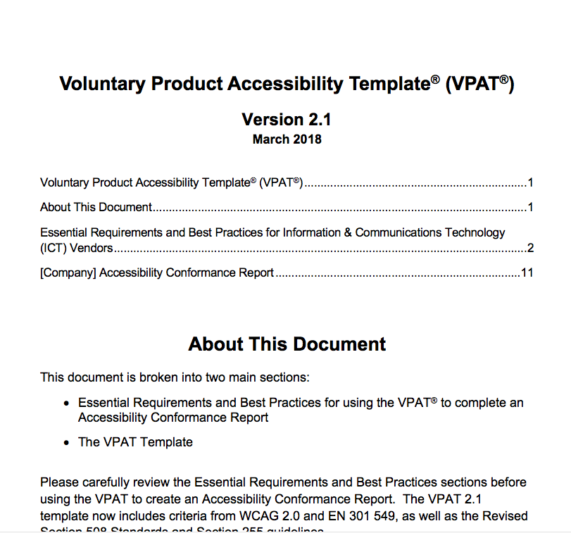
What’s different from VPAT® 1.0? (cont’d)
Introduction to VPAT® 2.1
“Accessibility Conformance Report”
Section 508, WCAG 2.0, and EN 301 549 in one template
“Voluntary”
FAQ page
Essential requirements
VPAT 2.0 released Oct 2017
VPAT 2.1 released Mar 2018
Takes into account Access Board correction related to Legacy TTY

Slide 10
VPAT® 2.1 Structure and Best Practices
Voluntary Product Accessibility Template® and VPAT® are registered trademarks of Information Technology Industry Council (ITI).

Slide 11
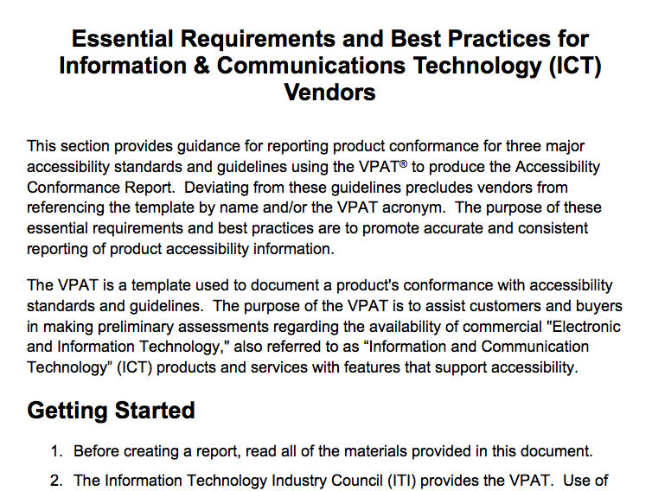
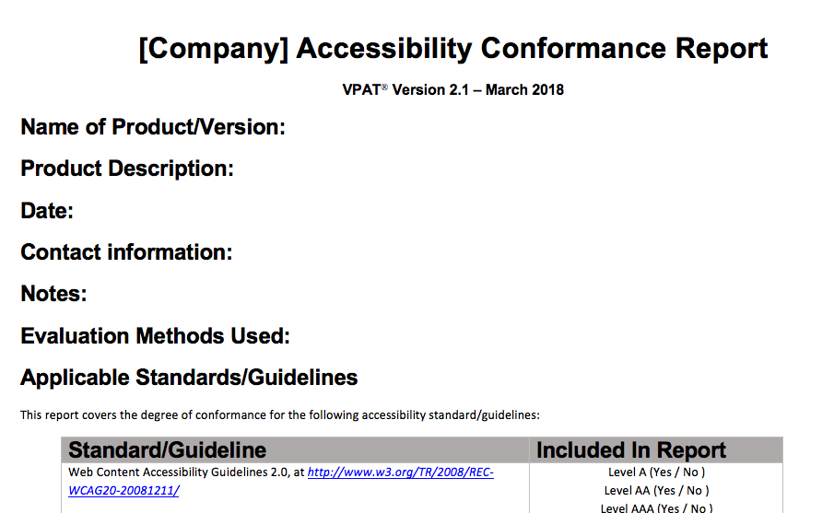
Structure of VPAT® 2.1
VPAT® 2.1 Structure and Best Practices
Extensive Instructions Essential requirements, best practices, and FAQs; Remove this section from reports.
Accessibility Conformance Report The actual template into which ICT product or service conformance will be documented.

Slide 12
Conformance Report Sections
VPAT® 2.1 Structure and Best Practices
Report Title: In the heading format of “[Company name] – Accessibility Conformance Report”
VPAT® Heading Information: VPAT® heading and acronym with service mark and template version
Name of Product: The name of the product being reported, including version of the product
Date: Date of report publication (month and year at minimum)
Contact Information: Contact information for follow-up questions
Notes: Any details or further explanations about the product or the report (may be left blank)

Slide 13
Conformance Report Sections (cont’d)
VPAT® 2.1 Structure and Best Practices
Standards/Guidelines: Indicate one or more Standards/Guidelines you evaluated against. “Not applicable” should be entered if you did not evaluate against a given Standard/Guideline.
Table Information: Table Information description section
Terms: Define terms your company is using for ‘Conformance Level’ column for level of support, if not using ITI defaults (be consistent)
Report Information: Standards/Guideline conformance information in 3-column tabular format
WCAG Tables: Conformance information for WCAG 2.0 conformance at the designated level (A, AA or AAA), also used for conformance with the Section 508 Refresh and EN 301 549

Slide 14
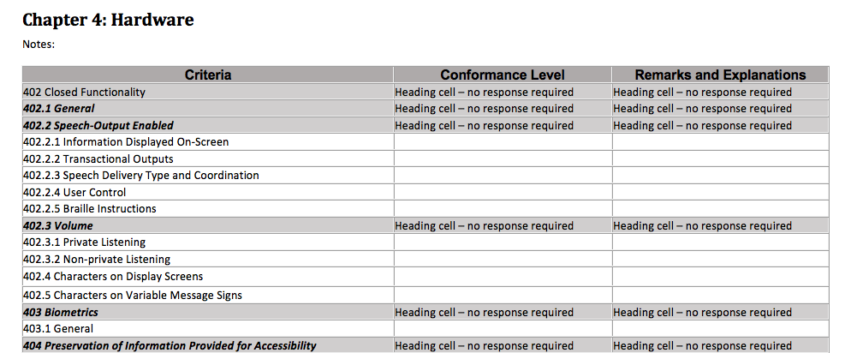
Conformance Report Section Example
VPAT® 2.1 Structure and Best Practices

Slide 15
Conformance Ratings
VPAT® 2.1 Structure and Best Practices
Default responses in Conformance Level column:
Supports
Supports with Exceptions
Does Not Support
Not Applicable
Not Evaluated (limited to WCAG 2.0 AAA)
When documenting conformance to WCAG 2.0:
A rating of “Supports” may be used in lieu of “Not Applicable” to document support for success criteria that do not apply to the product
In keeping with conventions for documenting conformance with WCAG 2.0
Notes:
ITI definitions for the ratings under the “Conformance Level” column must be used, or if the vendor deviates from these definitions then the vendor definitions must be documented in the “Terms” section of the VPAT, and this must be referenced in the “Notes” section
Supports: Functionality of product has at least one method that meets criteria without known defects or meets with equivalent facilitation. Note: The definition of Supports includes instances where the criteria is supported via the criteria not being applicable to the product, i.e. there is no content which violates the success criteria.
Supports with Exceptions: Some functionality of product does not meet criteria.
Does Not Support: Majority of functionality of product does not meet the criteria.
Not Applicable: Criteria are not relevant to the product. In the WCAG section, use ‘supports’ instead of ‘not applicable’ when reporting web conformance.
Not Evaluated: The product has not been evaluated against the criteria. This can only be used in WCAG 2.0 Level AAA.

Slide 16
Managing Size of Reports
VPAT® 2.1 Structure and Best Practices
Reduce size of reports by removing sections.
Individual criteria cannot be removed, only sections at a time.
Section removal is acceptable in four situations:
Entire standard is not being reported on (remove standard).
Entire section is not being reported on because it doesn’t apply to product (remove section).
Product is not being evaluated for a level of criteria (e.g. WCAG 2.0 Level AAA) then that table may be deleted.
Requesting customer has identified criteria for standard that do not apply.
Notes:
Section removal is acceptable in four situations:
When an entire standard is not being reported on, for example EN 301 549, there should be no references of it in the report.
When an entire section is not being reported on because it doesn’t apply to the product, for example Chapter 4: Hardware. Information should be included in the notes for that section why it’s been removed.
If product is not being evaluated for a level of criteria (for example Level AAA) then that table may be deleted.
If a requesting customer has identified that criteria for reporting standard does not apply.

Slide 17
Get Started with VPAT® 2.1 Today
Voluntary Product Accessibility Template® and VPAT® are registered trademarks of Information Technology Industry Council (ITI).

Slide 18




Is Your Company Ready for VPAT® 2.1?
Get Started with VPAT® 2.1 Today
Understand Applicability
Standardize Process
Testing All Requirements
Ensure Quality

Slide 19
Understand Applicability of Standards
Get Started with VPAT® 2.1 Today
Evaluate your product / service functionality
Determine which standards apply
Hardware, software, support documentation and services
Understand Applicability

Slide 20
Standardize VPAT® Authoring Process
Get Started with VPAT® 2.1 Today
Establish defined internal process and procedures to prepare VPAT®s
Implement internal standards to help ensure VPAT®s are complete and accurate
Standardize Process

Slide 21
Test Against All Applicable Standards
Get Started with VPAT® 2.1 Today
Use best practices to test multiple standards
Adopt proven and efficient audit methodology
Employ automated, manual, A/T validation, plus use case testing by PWDs
Testing All Requirements

Slide 22
Ensure VPAT® Quality & Accuracy
Get Started with VPAT® 2.1 Today
Train resources who prepare your VPAT®s and/or hire knowledgeable consultants
Keep your VPAT®s up to date.
Implement customer feedback loop for improvements.
Track business won/lost based on having effective VPATs®
Ensure Quality

Slide 23
Q&A and Resources

Slide 24

Resources
Win More Business! Report Product & Service Accessibility using VPAT® 2.1
European Union, Standard - EN 301 549
IT Industry Council, Accessibility Policy
Level Access, Navigating VPAT® 2.1 Whitepaper
Level Access, VPAT® Blog Articles
U.S. Access Board, ICT Final Standards and Guidelines (Section 508 Refresh)
W3C, Web Content Accessibility Guidelines 2.1

Slide 25





Thank You
Win More Business! Report Product & Service Accessibility using VPAT® 2.1
Contact
Follow Us
@LevelAccessA11y
Bill Curtis-Davidson
Sr. Director, Strategic Consulting Services
bill.curtis-davidson@levelaccess.com
Level Access
Level Access
Level Access Blog
Slide Deck Available for Download at: https://www.levelaccess.com/csun18/

